Slide 1
WAVEFORM CODING TECHNIQUES

Slide 2
PULSE CODE MODULATION (PCM)
It is a digital scheme for transmitting analog data.
It converts an analog signal into digital form.
Using PCM, it is possible to digitize all forms of analog data, including full-motion video, voice, music, etc.
Analog s/g is converted to digital and is represented as coded pulses.

Slide 3
3 basic parts in a PCM system are:
Transmitter
Transmission path
Receiver

Slide 4
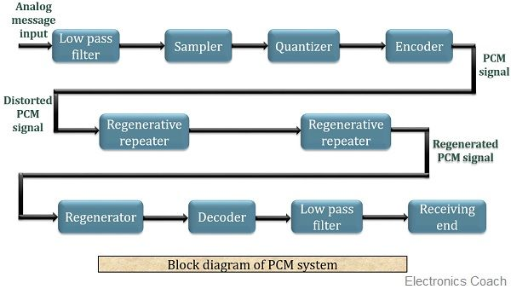

Slide 5
The transmitter performs the sampling, quantizing and encoding of the signal.
The transmission path includes regenerative receivers that recover the signal from the undesired noise effects.
Lastly, the receiver section that performs decoding of the coded signal after regeneration of the signal at the receiver.

Slide 6
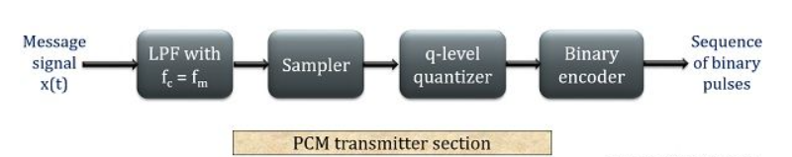
PCM TRANSMITTER

Slide 7
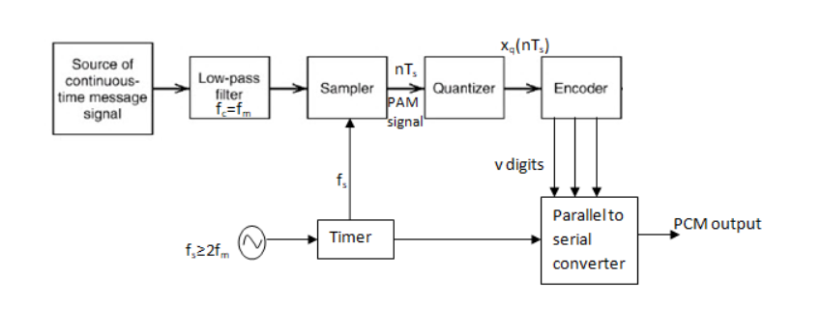
PCM TRANSMITTER

Slide 8
PCM transmitter consists of three steps to digitize an analog signal:
Sampling
Quantization
Binary encoding
Before we sample, we have to filter the signal to limit the maximum frequency of the signal as it affects the sampling rate.
Filtering should ensure that we do not distort the signal, ie remove high frequency components that affect the signal shape.

Slide 9
LPF: Here, the message signal which is in the continuous time form, is allowed to pass through a low pass filter (LPF). This LPF whose cutoff frequency is f_{m} eliminates the high-frequency components of the signal and passes only the frequency components that lie below f_{m}.
Quantizing & encoding oprs are usually performed in same ckt known as analog to digital converter(ADC).

Slide 10
The s/gs we use in real world are analog s/gs.
To process these s/gs in computers we need to convert these s/gs to its digital form.
Analog s/g is continuous in both time and amplitude.
Digital s/g is discrete in both time and amplitude.
Continuous time to discrete time ----- we use sampling.
Continuous amp to discrete amp ----- we use quantization.

Slide 11
Sampling
Analog signal is sampled every T_{S} secs.
T_{s} is referred to as the sampling interval.
f_{s} = 1/T_{s} is called the sampling rate or sampling frequency.
There are 3 sampling methods:
Ideal - an impulse at each sampling instant
Natural - a pulse of short width with varying amplitude
Flat top - sample and hold, like natural but with single amplitude value
The process is referred to as pulse amplitude modulation PAM and the outcome is a signal with analog (non integer) values

Slide 12
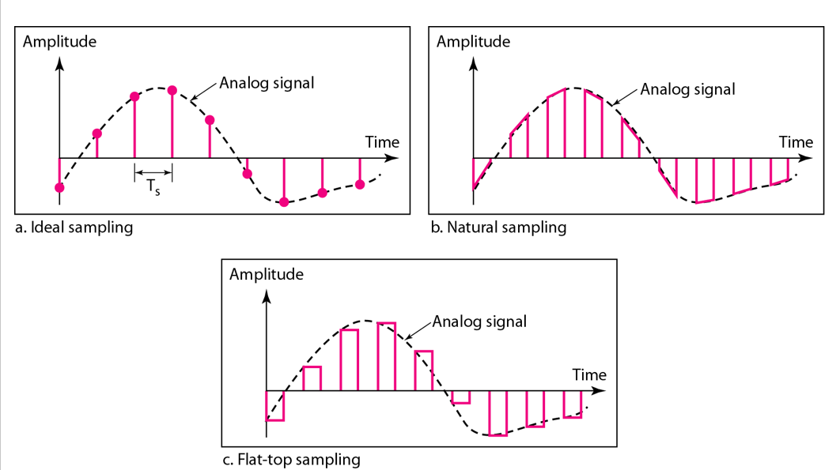

Slide 13
The o/p of a sampler will be discrete time continuous amplitude s/g x(nT_{s}).

Slide 14
$f$_{s} $≥2f\text{m}$
Sampling theorem (Nyquist theorem)
The sampling theorem (Nyquist thrm ) states that, “a continuous time signal can be completely represented in its samples and can be exactly reproduced if it is sampled at the rate f_{s} which is greater than or equal to twice the maximum frequency f_{m} of the message signal”.

Slide 15
Nyquist rate
If the sampling rate f_{s} is equal to twice the maximum frequency of the given signal f_{m}, then it is called as Nyquist rate.
$f$_{s} $=2f\text{m}$
This is also called as minimum sampling rate.
Nyquist interval
Maximum sampling interval is called as Nyquist interval.
$T$_{s} $= \frac{1}{2f\text{m}}$

Slide 16
The statement of sampling theorem can be given in two parts as:
A band-limited signal of finite energy, which has no frequency-component higher than f_{m} Hz, is completely described by its sample values at uniform intervals less than or equal to 1/ 2f_{m} second apart. T_{s} $≤1/2\text{f}\text{m}$
A band-limited signal of finite energy, which has no frequency components higher than f_{m} Hz, may be completely recovered from the knowledge of its samples taken at the rate of 2f_{m} samples per second. f_{s} $≥2f$_{m}

Slide 17
The first part represents the representation of the signal in its samples and minimum sampling rate required to represent a continuous-time signal into its samples.
The second part of the theorem represents reconstruction of the original signal from its samples. It gives sampling rate required for satisfactory reconstruction of signal from its samples.
The sampling theorem is stated by combining these two parts.

Slide 18
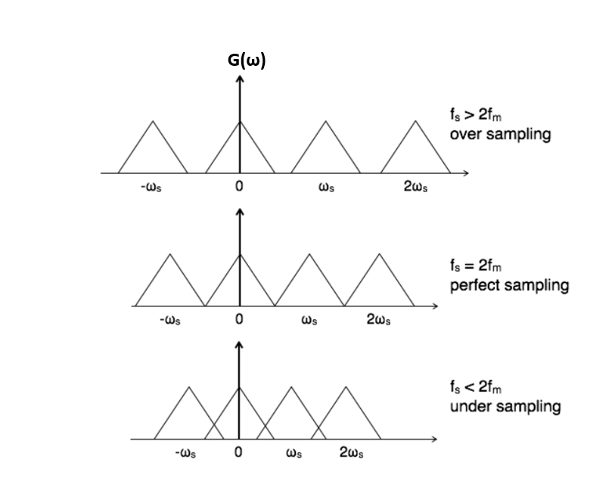

Slide 19
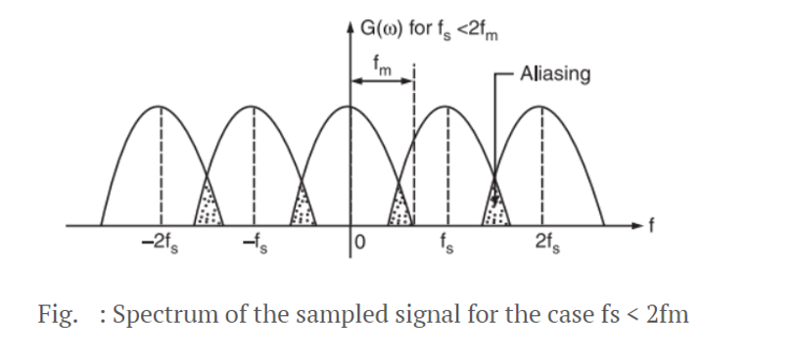
Aliasing (Undersampling)
When a continuous-time band-limited signal is sampled at a rate lower than Nyquist rate f_{s} < 2f_{m} , then the successive cycles of the spectrum G(ω) of the sampled signal g(t) overlap with each other as shown in fig.

Slide 20
The signal is under-sampled in this case (f_{s} < 2f_{m}) and some amount of aliasing is produced in this under-sampling process.
Aliasing is the phenomenon in which a high frequency component in the frequency-spectrum of the signal takes identity of a lower-frequency component in the spectrum of the sampled signal.
Bcoz of the overlap due to aliasing phenomenon, it is not possible to recover original signal x(t) from sampled signal g(t) by low-pass filtering since the spectral components in the overlap regions add and hence the signal is distorted.

Slide 21
To avoid aliasing:
Pre-alias filter must be used to limit band of frequencies of the signal to f_{m} Hz.
Signal is first passed through a LPF. This blocks all the frequencies which are above f_{m} Hz.
This process is known as band limiting of the original signal x(t).
This LPF is called pre-alias filter because it is used to prevent aliasing effect.
After band-limiting, it becomes easy to decide sampling frequency since the maximum frequency is fixed at f_{m} Hz.
(ii) Sampling frequency f_{s} must be selected such that f_{s} > 2f_{m}

Slide 22
This choice of having the sampling rate higher than Nyquist rate, also helps in the easier design of the reconstruction filter (interpolation) at the receiver.
The process of reconstructing continuous time signal from its samples is called interpolation.

Slide 23
